Slide 1
C29PE Economics for Professionals
Week 5 – Market Structure and Profit Maximisation
Sloman et al., 2023, Chapters 11 & 12

Slide 2
Session Aims
To understand the different types of market structures (perfect competition, monopoly and imperfect competition (oligopoly, monopolistic competition)
  What are the assumptions for a type market structure?
  What are the implications of these assumptions? How do firms behave?
  Are there any advantages or disadvantages for a particular type of market structure? Is the market structure favourable to consumers?
To compare/contrast the different types of market structure – what are the main characteristics of the market structures?
To provide some examples of market structures

Slide 3
References
Sloman et al (2023)
  Chapter 11.1 – 11.3
  Boxes 11.1 & 11.2
  Chapter 12.1 – 12.2
  Box 12.1
Important!
  The PowerPoint slide deck for Week 5 lecture provides a guideline of the topics you need to know. However, the materials in the slide deck are insufficient if you wish to excel in the course
  To do well, please do not forget to read the relevant sections of the core textbook
  Please also ensure that you follow economics news regularly as these sources could be used as examples to supplement your answers during assessments

Slide 4
Alternative market structures (consumer perspective)
Activity - discuss with the person next to you, or write down, answers to the following:
How many places are there within a few miles of where you live that you could get a coffee?
How many hair salons/barbers are there within a few miles of where you live?
Where would you go to do a food shop?
Would you ever ask for a cola rather than a Coke?
Have you ever used the term ‘I will google’ it to research something on the web?
Would you consider upgrading your mobile to anything other than an iPhone?
Have you bought anything from Amazon in the last couple of weeks?

Slide 5
Alternative market structures (firm perspective)
What links the following important questions?
Will profits be large, or just enough for a firm to survive, or so low they will be forced out of business?
Will the firm produce a high level of output or a low level? Will it be producing efficiently?
Will the price charged to the consumer be high or low?
Why do we see constant advertising and innovation in some products, while others are rarely promoted?
Why do prices fall in some industries and rise in others?
Why is the government more concerned with the behaviour of firms in just some industries?
We see markets with many competitors and others with few. Why does this happen?
These questions can all be answered by looking at the structure of an industry and the degree of competition.

Slide 6
Alternative Market Structures
Factors affecting the degree of competition
Number of firms - the more firms there are competing against each other, the more competitive any market is likely to be, with each firm trying to steal customers from its rivals.
  One strategy will be to keep prices low, which will generally be in the consumer’s interest.
Freedom of entry and exit of firms into the industry - free, restricted or blocked?
  No barriers to entry – easier for new firms to set up
Nature of product - homogeneous or differentiated?
  If firms produce an identical product, there is little a firm can do to gain an advantage over its rivals. If firms produce their own brand/model/variety, they may be able to charge a higher price and/or gain market share.
Nature of demand curve - degree of control the firm has over price.
  Is it a price taker or price maker. How elastic is the demand curve?
Notes:
2

Slide 7
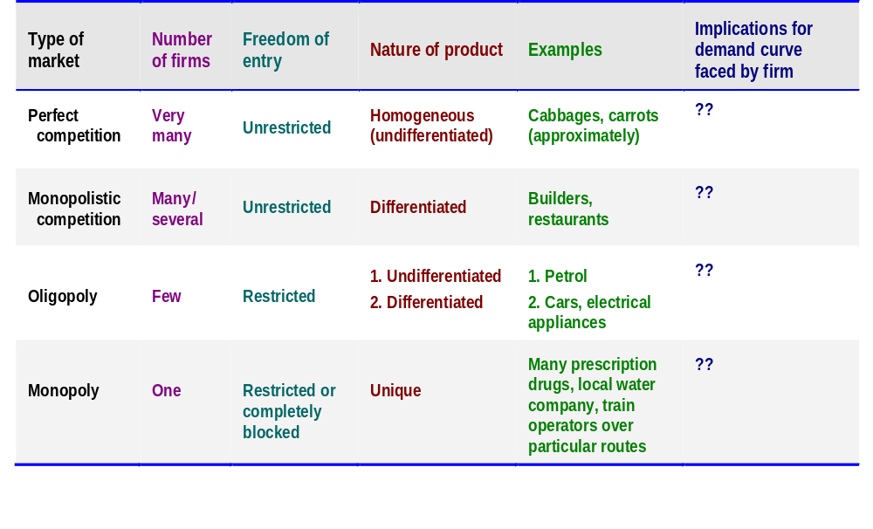
Features of the four market structures
Activity – Discuss with a partner what you think the demand curve for each type of market will look like.

Slide 8
Perfect Competition
Most firms in the real world operate under imperfect competition
  It is still worth studying the two extreme cases (perfect competition and monopoly)
  They provide a framework within which to understand the real world and benchmarks for comparison
Perfect Competition – Assumptions
  Firms are price takers
  There is complete freedom of entry of firms into the industry for new firms
  All firms produce an identical product
  Producers and consumers have perfect knowledge of the market
  Producers are fully aware of prices, costs, technology and market opportunities
  Consumers are fully aware of price, quality and availability of the product
*These assumptions are very strict. Few, if any, industries in the real world meet these conditions. Certain agricultural markets, perhaps, are closest to perfect competition. For e.g., the market for fresh vegetables.
Notes:
4

Slide 9
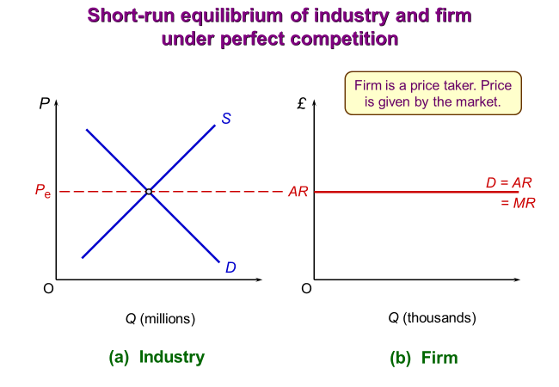
Perfect Competition
Short-run equilibrium of the firm
Assumption that there is no time for new firms to enter the market
Price
  Determined in the industry by the intersection of market demand and supply
  The firm faces a horizontal demand (or AR) ‘curve’ at this price
  Since the price is not affected by the firm’s output, MR will equal price (price is constant at P_{e})
Output
  The firm will maximise profits where MR = MC, at an output of Qₑ
  As MR = P, the firm will produce where P = MC
Activity – Add an MC and AC curve to the diagram on the right.

Slide 10
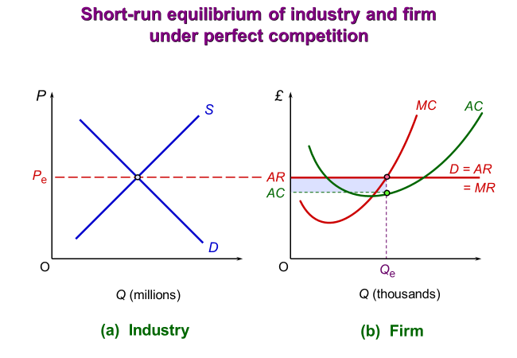
Perfect Competition
Profit
If the AC curve (which includes normal profit) dips below the AR ‘curve’, the firm will earn supernormal profits
Supernormal profit per unit at Q_{e} is the vertical distance between AR and AC at Q_{e}.
Total supernormal profit is the shaded rectangle.

Slide 11
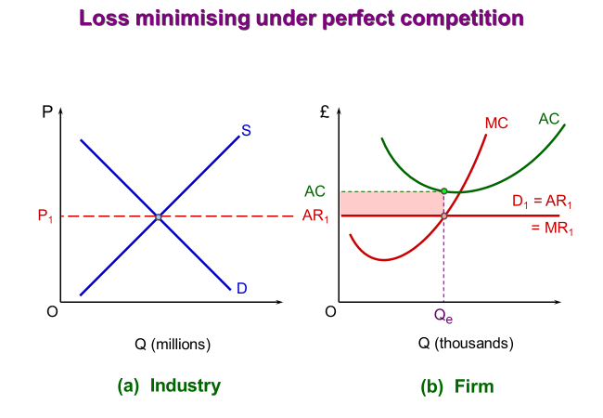
Perfect Competition
Profit
If the firm cannot make a profit at any level of output (i.e., the AC curve is above the AR curve at all points, then MR = MC will represent the loss-minimising point.

Slide 12
Perfect Competition
Long-run equilibrium of the firm
  If typical firms are making supernormal profits, new firms will be attracted to the industry and existing firms will increase their operations resulting in a higher quantity being produced at every price level
  The industry supply curve will shift to the right, which in turn, leads to a fall in price
  Supply will go on increasing and price falling, until firms are only making normal profit
  All supernormal profits are competed away
Incompatibility of economies of scale with perfect competition
  In most cases, firms are too small to achieve economies of scale
  Once a firm expands sufficiently to achieve economies of scale, it will usually gain market power. Smaller firms will be driven out of business and perfect competition destroyed.
Notes:
5

Slide 13
Perfect Competition
Does the firm benefit from operating under perfect competition?
  Constant battle for survival – if it becomes less efficient that other firms, it will make less normal profits and be driven out of business. If it becomes more efficient, it will earn supernormal profits, but they will not last for long as other firms will copy.
Does the consumer benefit from perfect competition?
  Productive efficiency – firms are producing the maximum output for a given amount of inputs, or producing a given output at the least cost
  Low prices
The role of e-commerce
  Is e-commerce like perfect competition? Many new firms have been able to set up small businesses (for e.g., on eBay), start-up costs tend to be low, the Internet has added to consumer knowledge.
  The future? Online retailers predicted to represent 25% of the retail market by 2025.
Notes:
5

Slide 14
Monopoly
Activity – discuss with the person next to you or write down:
  1. What you think a monopoly is
  2. An example of a real-world monopoly
  Real life example:
  landlords-v3 (youtube.com)
Notes:
8

Slide 15
Monopoly
In simple terms – a monopoly exists when there is only one firm in the industry
However, whether an industry can be classed as a monopoly is not always clear – it depends on how narrowly the industry is defined
  For example, a textile company may have a monopoly on certain types of fabric, but it does not have a monopoly on fabrics in general
  For example, an ice cream company may have a monopoly on the sale of ice cream in a particular theatre, but it does not have a monopoly on ice cream in general.
Importance of market power
  To some extent, the boundaries of an industry are arbitrary.
  Importance of closeness of substitutes produced by rival industries.
  A train company may have a monopoly over railway journeys between two towns, but it may face competition in transport from cars, coaches and sometimes planes.
Notes:
8

Slide 16
Monopoly
Barriers to entry: for a firm to maintain its monopoly position, there must be barriers to entry of new firms.
  Economies of scale
    If the monopolist’s AC go on falling significantly up to the output that satisfies the whole industry, the industry may not be able to support more than one producer (natural monopoly).
      For example, the network of pipelines that supply gas to homes and businesses.
  Economies of scope
    For example, shared research, marketing, storage and transport facilities across a range of products
  Product differentiation and brand loyalty
    Consumers associate the product with a brand, for example ‘Hoover their carpet’ or ‘Google it’
    The monopolist may also have access to superior technology
  Lower costs for an established firm
    An established monopoly is likely to have developed the most efficient way of producing and marketing its product and this will be difficult for other competitors to replicate.
    It may also be aware of the cheapest suppliers and have access to cheaper finance
Notes:
8

Slide 17
Monopoly
  Access to, control over or ownership of key inputs or outlets
    For instance, Amazon purchased Kiva Systems (the leading supplier of robotics for warehouse operators and retailers)
  Legal protection
    The firm’s monopoly position may be protected by patents on essential processes, by copyright, by various forms of licensing and by tariffs and other trade restrictions to keep out foreign competitors.
    For example, most new medicines developed by pharmaceutical companies are protected by patents
  Mergers, takeovers and aggressive tactics
    The sheer threat of takeovers may discourage new entrants
    An established monopolist is likely to have some retained profits behind it which it can use to help sustain losses whilst it engages in a price war, mounts an advertising campaign or offers deals
    New entrants may struggle to access customers, if customers incur costs when moving supplier
    Consumers may decide not to switch due to network economies, for example, people sell on eBay, because it is used by so many people.
Notes:
8

Slide 18
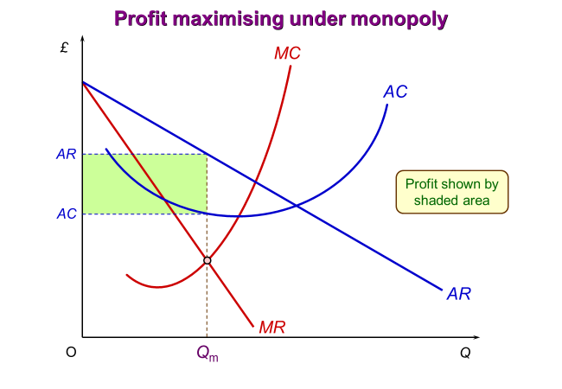
Monopoly
The monopolist’s demand curve
One firm in the industry means the firm’s demand curve is also the industry demand curve
Elasticity will depend on availability of substitutes in other industries)
The monopolist is a ‘price maker’, but it is still constrained by its demand curve (a rise in P, will lead to a fall in Q)
So, MR lies below AR
Equilibrium price and output
Monopolist will maximise profits where MC = MR
Profits will tend to be larger the less elastic the demand curve
Barriers to entry of new firms - a monopolist’s supernormal profits will not be competed away in the long run
Notes:
8

Slide 19
Monopoly versus Perfect Competition
The monopolist will often produce a lower output at a higher price in the short-run than a firm under perfect competition
  The profit maximising price is higher, and the profit-maximising level of output is lower under monopoly than under perfect competition (assuming the same cost curves)
The monopolist may also produce a lower output at a higher price in the long run
  barriers to entry allow supernormal profits in the long run
On the other hand, the monopolist may be able to achieve substantial economies of scale and pass these on to consumers in the form of lower prices.
A monopolist may not have the same incentive to become efficient as a perfectly competitive firm, but it may have much greater ability.
Notes:
8

Slide 20
Monopolistic Competition
Very few markets in practice can be classified as perfectly competitive or as a pure monopoly.
Most firms do compete with other firms, often quite aggressively, and yet they are not price takers: they do have some degree of market power.
Most markets lie between the two extremes of monopoly and perfect competition.
Monopolistic competition combines some of the characteristics of monopoly and some of the characteristics of perfect competition.
Monopolistic competition is a form of ‘imperfect competition’.
Notes:
2

Slide 21
Monopolistic Competition
Assumptions of monopolistic competition
Large number of firms
  Each firm does have some degree of market power though
  Small market shares – one firm’s actions are unlikely to affect its rivals to any great extent
  Independence of firms – when a firm makes a decision, it will not have to worry about how its rivals will react
Freedom of entry - if any firm wants to set up in business in this market, it is free to do so
Differentiated product - each firm produces a good or service that is in some way different from its rivals, for e.g., petrol stations, restaurants, hairdressers, builders
Downward-sloping demand curve - demand elasticity depends on degree of product differentiation – can raise price without losing all its customers
Notes:
2

Slide 22
Monopolistic Competition
Equilibrium of the firm
  As all firms under monopolistic competition are producing a slightly differentiated product, we cannot create an industry demand or supply curve.
  Activity – sketch the short-run equilibrium of the firm under monopolistic competition.
  Hints
    Look back to the diagram showing the equilibrium of a monopolist and think about the difference(s) between a monopolist and a firm under monopolistic competition.
    You will need P (price) on the y-axis and Q (quantity) on the y-axis of your diagram and you will need to include: the AR curve, the MR curve, the MC curve and the AC curve.
Notes:
2

Slide 23
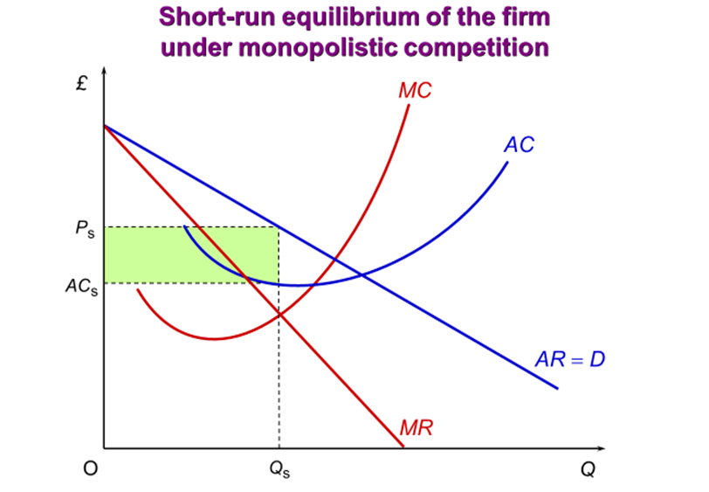
Monopolistic Competition
Equilibrium of the firm in the short run
As all firms under monopolistic competition are producing a slightly differentiated product, we cannot create an industry demand or supply curve.
Profits are maximised at the output where MC = MR
The diagram will be the same as for the monopolist, except the AR and MR curves will be more elastic, due to more competition.
Level of supernormal profit depends on demand the position and elasticity of demand curve.
Notes:
2

Slide 24
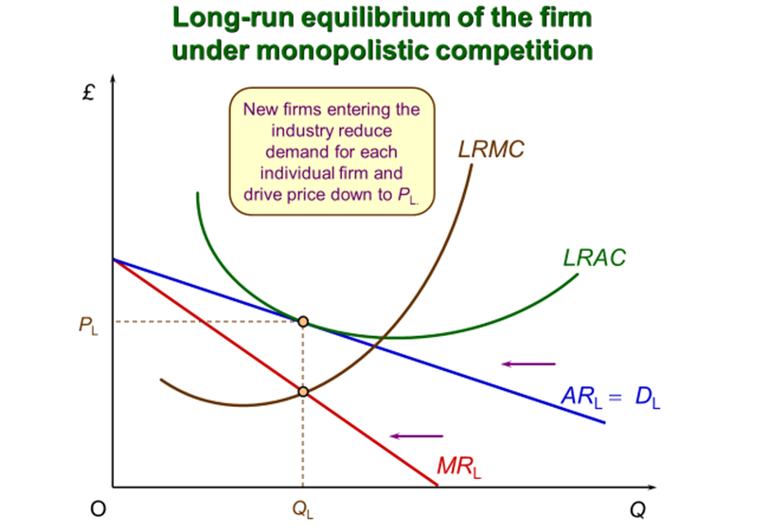
Monopolistic Competition
Equilibrium of the firm in the long run
If typical firms are earning supernormal profits, new firms will enter the industry in the long run.
The demand (AR) curve for the established firms’ products will therefore shift to the left (as demand for their product falls)
All supernormal profits are competed away
Long-run equilibrium will be reached when only normal profits remain – when there is no incentive for new firms to enter.
Notes:
2

Slide 25
Monopolistic Competition
Limitations of the model when trying to apply it to the real world:
  Imperfect information – firms may not know that supernormal profits are currently being made in an industry or what the demand is for the product they are considering selling
  Entry may not be totally free
    For e.g., two petrol stations could not set up in the same place because of local authority planning controls
  Indivisibilities – existing firms may make supernormal profits, but if a new firm entered, this might reduce everyone’s profits below the normal level. Thus, a new firm will not enter, and supernormal profits will persist into the long run.
  Importance of non-price competition – profit-maximising firms under monopolistic competition will need to think about more than just price (for e.g., the exact variety of product to produce)
Notes:
3

Slide 26
Monopolistic Competition
Comparing monopolistic competition with perfect competition and monopoly
  Comparison with perfect competition
    Although the firm under monopolistic competition may charge a higher price than under perfect competition, the difference may be very small – the firm’s demand curve is downward sloping, but it is likely to be highly elastic due to the large number of substitutes.
    The consumer may benefit from monopolistic competition by having a greater variety of products to choose from.
  Comparison with monopoly
    Freedom of entry for new firms and hence the lack of long-run super-normal profits under monopolistic competition are likely to help keep prices down for the consumer and encourage cost saving.
    On the other hand, monopolies are likely to achieve greater economies of scale and have more funds for investment and research and development.
Notes:
3

Slide 27
Oligopoly
Oligopoly occurs when just a few firms share a large proportion of the industry between them
Some of the best-known companies are oligopolists, including Ford, Coca-Cola, Apple, EDF and Tesco
  Firms may produce a virtually identical product (for e.g., metals, chemicals, sugar, petrol), but in most cases, oligopolists produce highly differentiated products (for e.g., cars, soap powder, soft drinks, electrical appliances) - much of the competition in the latter case is in terms of the marketing of the brand
Two key features of oligopoly
  Barriers to entry - there are various barriers to the entry of new firms. The size of the barriers will vary from industry to industry.
  Interdependence of firms - with only a few firms under oligopoly, each firm will need to take account of the behaviour of the others when making its own decisions. This means they are mutually dependent.
What is an Oligopoly? (youtube.com)

Slide 28
Oligopoly
Competition and collusion
The interdependence of oligopolists means firms are pulled in two different directions: to compete or to collude.
  Pressures to compete: to maximise their share of industry profits
    For e.g., by cutting prices or undertaking advertising with the aim of increasing sales.
    However, if all firms cut prices, each unit sold now earns less revenue; if all firms increase advertising, average costs will rise. Either way, profits are likely to fall.
  Pressures to collude: to maximise industry profits
    Collusion may be a more profitable strategy than competing.
    Agreements with the other firms on price, output, product design, etc.,
    This may be bad for consumers, and most countries have competition laws that try to prevent open collusion.

Slide 29
Oligopoly
  Collusion (on prices, market share, advertising expenditure, etc.) reduces uncertainty for firms.
  A formal collusive agreement is called a cartel
  The cartel will maximise profits by acting like a monopolist, with the members behaving as if they were a single firm.
  The most famous example of a cartel is OPEC, which was set up in 1960 by the five major oil-exporting countries.
  Where open collusion is illegal, firms may simply break the law or find ways to get around it.
  Alternatively, firms may stay within the law, but still tacitly collude.
  One form of tacit collusion is where firms keep to the price that is set by an established leader.
  Other forms of tacit collusion – ‘rules of thumb’ that everyone follows (for e.g., price benchmarks, advertising rules).
  Collusion between firms, whether formal or tacit, is more likely when firms can clearly identify with each other or some leader and when they trust each other not to break agreements.

Slide 30
Cartel instability
Agreement to reduce production needs to be policed
  Cartel increases industry profit by reducing firms’ output
  Firms can exploit cartel by joining it – then ignoring output restriction
    If one firm does that, it makes greater profit
    If all firms do that, the cartel collapses, and all make smaller profits
  Cartels are inherently unstable
    In many countries, they are also unlawful – regulation prohibits their formation
Brief review of OPEC’s role in guiding oil production in next slide
  Detailed guide in Box 12.1: OPEC

Slide 31
When might collusion survive?
When there are few firms in an industry, which share all data
  No large differences in cost structures, production methods, or outputs
    Will respond in much the same way to changes in market conditions
    Weak brand identity, few differences in quality, and little market segmentation
    Willing to accept common prices for outputs
Also, where a dominant firm can discipline other firms
  Industry structure stable, with significant barriers to entry, and few changes in demand and supply conditions
  Government is tolerant of cooperation among firms
    May be seen that cooperation leads to more rapid growth
Notes:
31

Slide 32
Why collusion breaks down
Firms always have an incentive to cheat
  So agreements are likely to build in punishments for breaking them
  Competitors have to be able to spot cheating
    How easy is it to measure the quantity of output being shipped from a plant
    Requires substantial information
  Will competitors impose punishments?
    Ideally should involve flooding market, pushing prices down, imposing large costs on cheat
    But would competitors win the price war?

Slide 33
Oligopoly
Non-collusive oligopoly:
  Even though oligopolists might not collude formally or tacitly, they will still need to take account of rivals’ likely behaviour when deciding their own strategy
  Firms will make assumptions about how they believe their rivals will behave
    Assumptions are likely to be based on past behaviour

Slide 34
Oligopoly and the Consumer
  Disadvantages
    If oligopolists act collusively and jointly maximise industry profits, they will, in effect, be acting as a monopoly. In such cases, prices may be very high.
    There may be less scope for economies of scale to lower costs, relative to monopoly
    Oligopolists are likely to engage in much greater use of advertising than under monopoly which will increase costs (and may lead to higher prices for consumers).
  These problems will be less severe if oligopolists do not collude – if there is some degree of price competition and if barriers to entry are weak.
Notes:
8

Slide 35
Oligopoly and the Consumer
Advantages
  Oligopolists, like monopolists, can use part of their supernormal profit for R&D. Unlike monopolists, however, oligopolists will have a considerable incentive to do so.
      If the product design is improved, this may allow the firm to capture a larger share of the market.
      Costs may be reduced by technological improvements
  Non-price competition through product differentiation may result in greater choice for consumers.
  It is difficult to draw any general conclusions about the outcomes in this market structure, since oligopolies differ so much in their behaviour and performance.
  Although an oligopoly is closer to the non-competitive end of the spectrum, it can still be a highly competitive market structure.
Notes:
8

Slide 36
Market Structure
Activity – write down the key characteristics of each of the four market structures, including the profit maximising output. Provide examples for each market structure.
Notes:
8

Slide 37
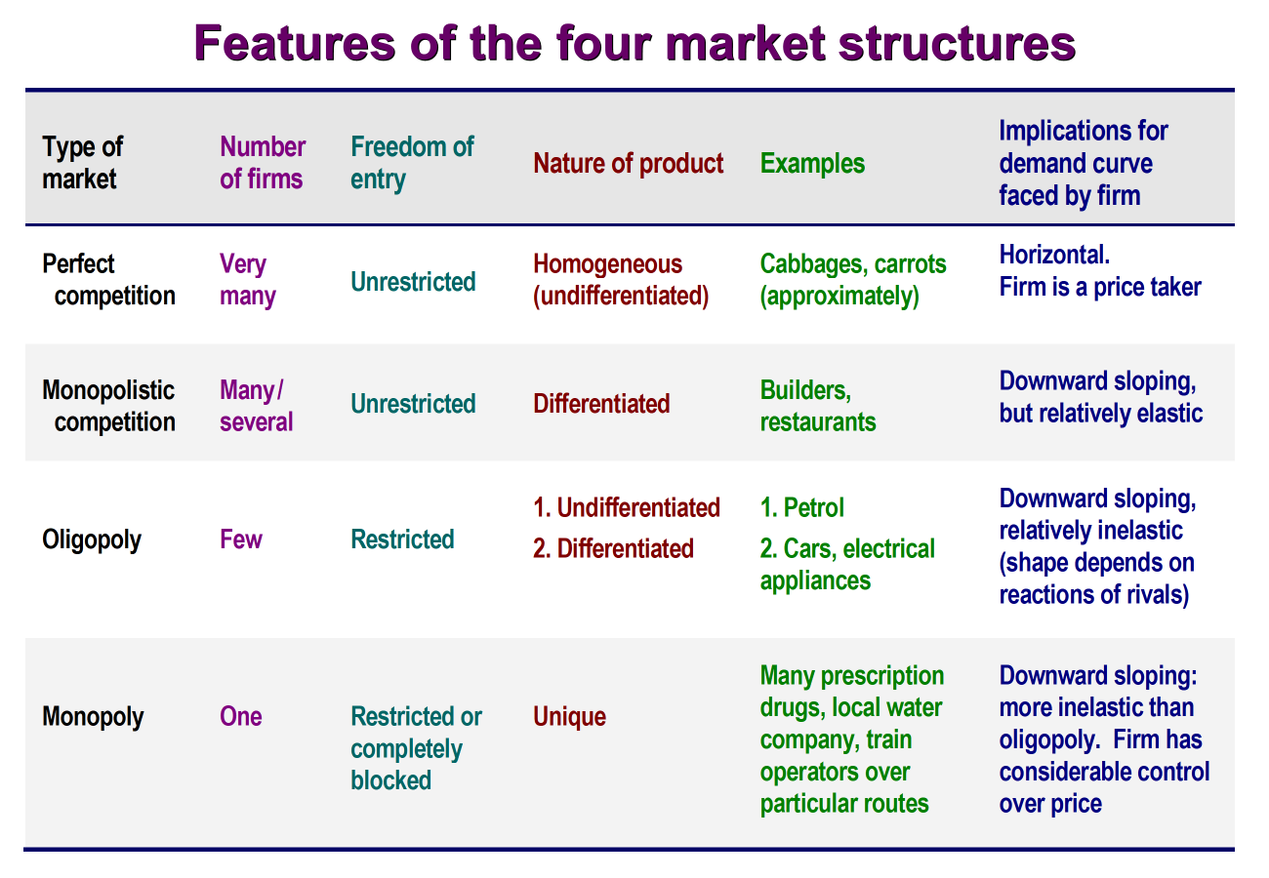
Market Structure
For all market structures:
profit-maximising output is where MR = MC
For perfectly competitive firms, profit is also maximised where P = MC
Notes:
8

Slide 38
Summary
The number of firms in the market, the freedom of entry and exit, the nature of the product and the nature of the demand curve all affect the degree of competition.
Perfect competition is at one end of the continuum of market competition and monopoly is at the other.
All firms, operating under any market structure, maximise profits where MR = MC.
Perfectly competitive firms also maximise profits where P = MC.
A monopolist may not have the same incentive as a perfectly competitive firm to become efficient and produce at low prices and high outputs, but it has the ability.
Due to strong interdependence between oligopolists, firms need to decide whether to compete or collude.
Notes:
8

